Slide 1

Asymmetric Multiprocessing (AMP)
Symmetric Multiprocessing (SMP)
Primary Core
(runs OS)
Secondary Core
Primary Core
(runs OS)
Primary Core
(runs OS)
Secondary Core
Secondary Core
Primary Core
(runs OS)
Primary Core
(runs OS)

Slide 2
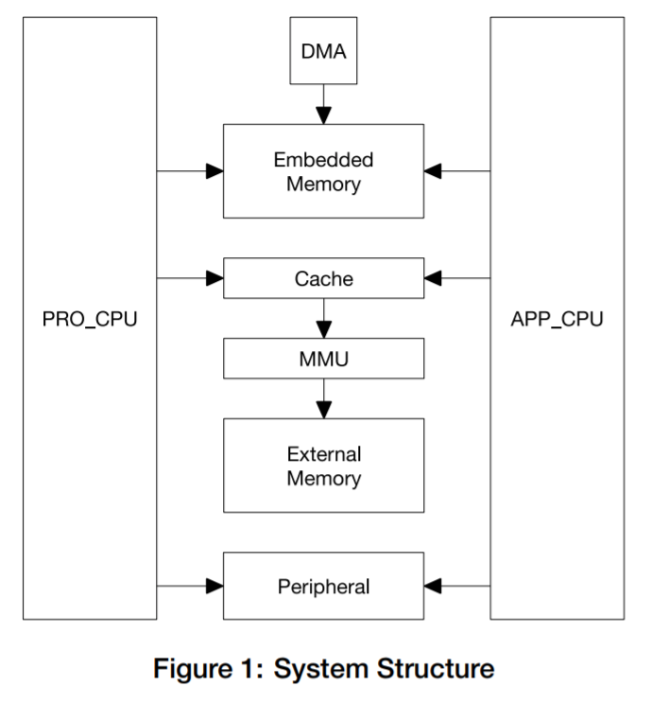

ESP32 Block Diagram
(example of SMP architecture)
32 KB
32 KB
Core 0 Cache
Core 1 Cache
0
1
Task A
Scheduler
Scheduler
(diagram is from the ESP32 Technical Reference Manual)

Slide 3

ESP32 Block Diagram
(example of SMP architecture)
Interrupts
Interrupts
32 KB
32 KB
Core 0 Cache
Core 1 Cache
0
1
Scheduler
Scheduler
(diagram is from the ESP32 Technical Reference Manual)

Slide 4
To pin, or not to pin?
Advantages of pinning
a task to a core
Advantages of letting
the scheduler(s) decide
Knowing location of interrupts
More control of core usage
Fewer cache misses
More deterministic
Easier to use
Optimized core usage
Automatic load balancing

Slide 5
Core 0
Core 0
After 10 samples have been read, Task A will wake up and compute the average.
Double Buffer or Circular Buffer
Task A
Global:
Average (float)
Timer ISR
Samples from ADC (10 Hz)
Core 1
Task B
Serial Terminal
> hello
> avg
Average: 59.2
> blah
>

Slide 6
To pin, or not to pin?
Advantages of pinning
a task to a core
Advantages of letting
the scheduler(s) decide
Knowing location of interrupts
More control of core usage
Fewer cache misses
More deterministic
Easier to use
Optimized core usage
Automatic load balancing

